Slide 1

Early Years Apprenticeship Surgery

Slide 2


What is an apprenticeship?
An apprenticeship is a learning programme that allows learners to learn while they earn.
Notes:
Apprentices are members of staff
Apprentices must have a contract of employment that covers the duration of their programme
Apprentices cannot contribute to the cost of their training
Apprentices must be allowed time to study
Apprentices must be on programme for a minimum of 12 months
Employers (Mentors) must attend and contribute to the Apprentice Induction and agree the individual learning plan
This is a collaboration whereby BPN supports the Employer and the apprentice

Slide 3
What is an apprenticeship made up of?
Standard (Knowledge, skills and behaviours)
Maths and English
Off the job training
Gateway
End point assessment
Additional qualifications (E.g. paediatric first aid)
Notes:
Apprenticeship elements:
Standard – knowledge, skills and behaviours to be met
Maths and English FS
Off the job training
Gateway – confirm ready for EPA
EPA

Slide 4

What are the benefits of an apprenticeship?
Provides an opportunity to earn money while you learn
Develop practical skills in a real work environment.
Support and mentoring within the workplace
Career progression: Build a foundation for higher-level qualifications or future job roles.
Fully funded – learn without incurring student loans or tuition fees
Gain valuable work experience that stands out to future employers.
Gain a nationally recognised Qualification
Develop soft skills, such as communication, team work and problem solving skills
Notes:
Earn While You Learn: Gain a salary while acquiring skills and qualifications.Hands-On Experience: Develop practical skills in a real work environment.
Support and Mentoring: Work alongside experienced professionals who guide and support you.Career Progression: Build a foundation for higher-level qualifications or future job roles.Avoid Student Debt: Learn without incurring student loans or tuition fees.Boost Employability: Gain valuable work experience that stands out to future employers.Gain a Nationally Recognized Qualification: Achieve a respected certification that opens up more opportunities.Develop Soft Skills: Improve communication, teamwork, and problem-solving skills.

Slide 5

What will I be doing as an Early Years Apprentice?
Support children's learning and development
Assist with planning and delivering activities
Ensure the safety and wellbeing of children
Help with personal care, including feeding and changing
Follow safeguarding procedures
Communicate effectively with children, parents, and colleagues
Maintain a clean and safe environment
Support the inclusion of all children
Keep accurate records and observations
Participate in team meetings and training sessions

Slide 6
Early Years Apprenticeships Level 2 and 3
Early Years Practitioner Level 2 | Early Years Educator Level 3
Designed for those who are brand new to an early years setting/ not quite ready for Level 3 | Designed for those working in an early years setting with some relevant EY experience
13 months + 3 months end point assessment | 15 months + 3 months end point assessment
Functional skills maths and English L1 | Functional skills maths and English Level 2
Early Years Practitioner Level 2 diploma must be completed | Paediatric first aid Level 3 must be completed
9 core modules | 11 core modules

Slide 7

How will my apprenticeship be delivered?
Virtual classrooms
1-2-1 Tutor Support
BPN boost – personal development, career information advice and guidance and welfare programme
Independent research
Progress reviews every 6 weeks
Workplace learning

Slide 8
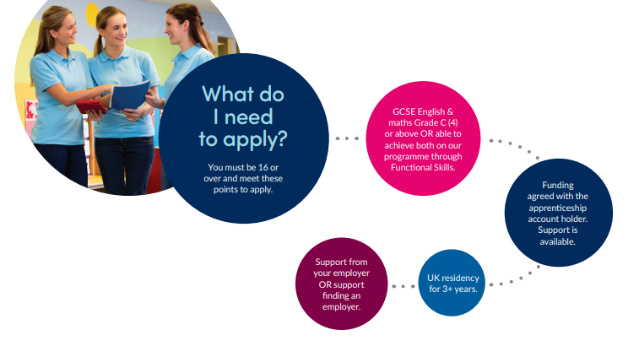

Slide 9

Additional Learning Support

Slide 10
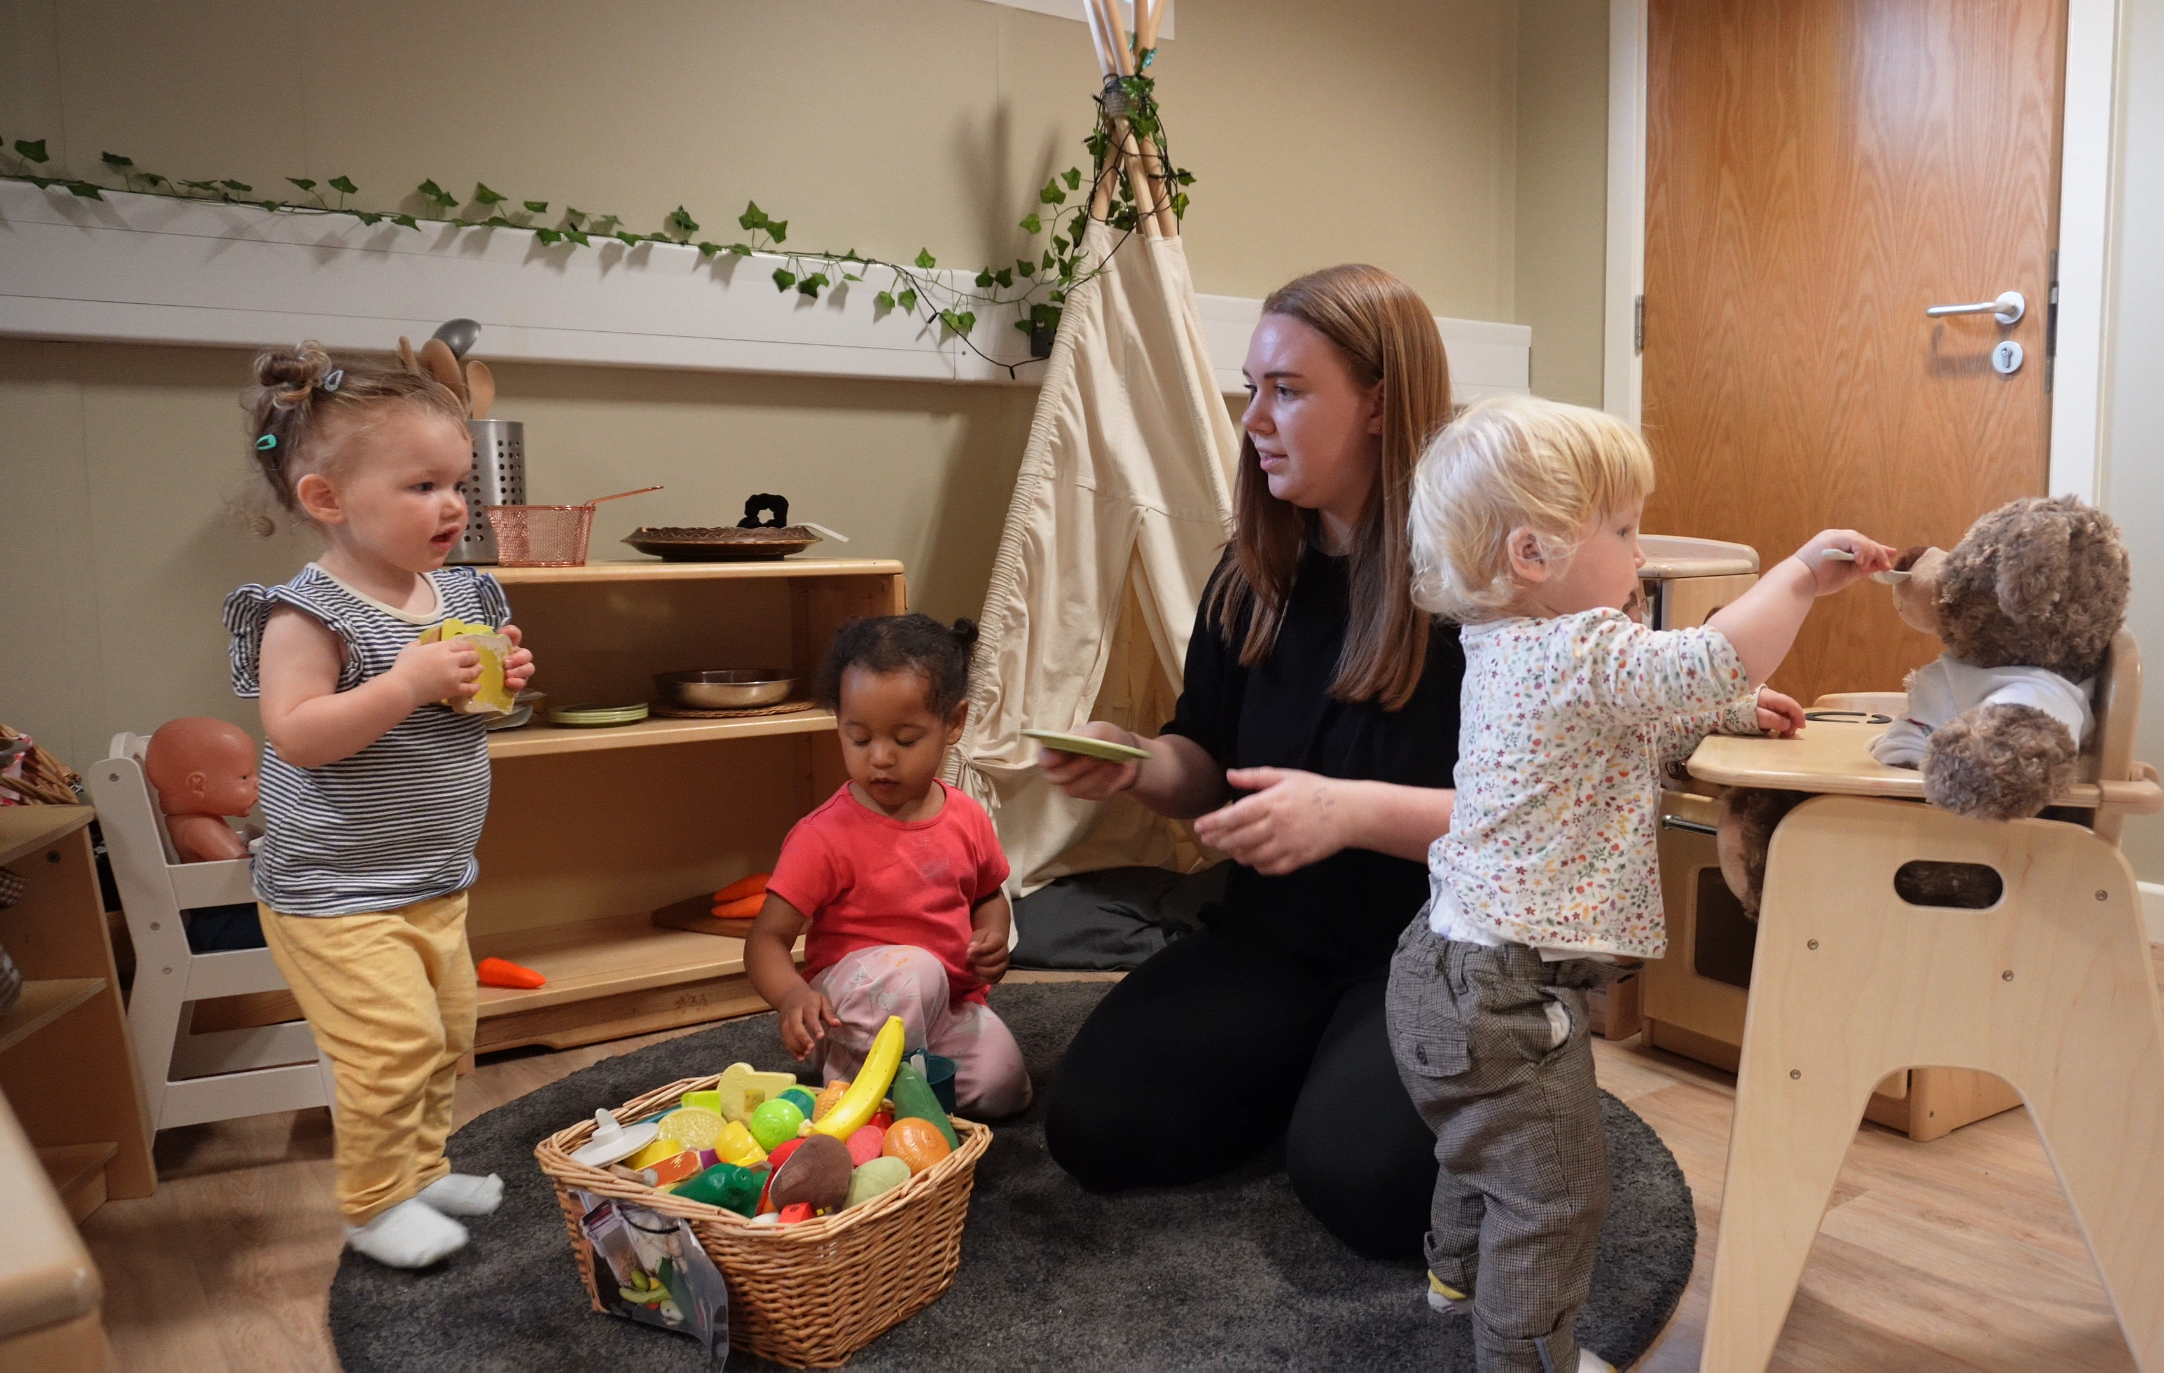
What is Additional Learning Support? (ALS)
What we mean by Additional Learning Support
Why we offer support
Who can request Additional Learning Support with their apprenticeship

Slide 11

Examples of additional learning needs
Communication and interaction
Cognition and learning
Social, emotional and mental health difficulties (SEMH)
Sensory and/or physical needs
Any area of need identified by the SEND Code of Practice (DfE and DoH, 2015).

Slide 12

How we support your learning
The Best Practice Network process:
Identify additional learning needs
Complete needs analysis
Review information
Take appropriate action

Slide 13
Unplaced Learners

Slide 14
What is an unplaced learner?
A candidate that has no employer and has applied for an apprenticeship.
Notes:
When you apply for an apprenticeship with Best Practice Network, if you have no employer, you would be classed as an unplaced learner. This term allows us to understand that you need support with finding an employer.

Slide 15

What happens after you apply?
You will be placed into the unplaced cohort.
Screening Form/Call.
Check current vacancies, we will discuss any details with you.
If there are no vacancies, we will offer support on how to approach local settings.
CV sent to any vacancies.
Notes:
You will be placed into the unplaced cohort – this allows the placement resourcers to prioritise finding you an employer.
A screening form or call would need to be completed so that we can check your eligibility and requirements for a role.
Check current vacancies – We will see what vacancies we have in your local area. If we have live vacancies, we will discuss the details of the role with you and get your CV sent if you are interested,
If there are no vacancies, we will support you in finding vacancies by contacting local settings and asking if they have or will have any apprenticeship vacancies. We also have brochures that can guide you on how to approach employer.

Slide 16

If you are selected…
Interview at the setting – stay and play/work trial
Feedback
We process application on our system.
Employment checks – References, DBS, ID check
If you are not successful, we will continue the search for an employer.
Notes:
If you are invited to an interview, we will arrange a suitable date and time. Sometimes employers would ask you to stay for some time, maybe an hour to complete a stay and play. The employers are looking to see how you engage with the children. You will be sent some interview guidance that can be used to gain confidence.
The employer will then give me feedback on whether you are successful or not.
If you are successful, we will process your application to start the enrolment process. You would need to go through standard employment checks such as applying for a DBS if you have not already got one, checking your references, so please ensure you have 2 referees details available and ID check.

Slide 17


FAQ
Is it guaranteed you will find me an employer?
  Unfortunately, we cannot guarantee finding you an employer as this is a competitive market.
How long will it take to find a vacancy?
  The duration can vary on locations and available vacancies.
What support is offered?
  Best Practice Network have various brochures, interview guidance and support from the Placement Resourcers.
Notes:
Is it guaranteed you will find me a placement – Unfortunately, we cannot guarantee we will find you a placement

Slide 18


Next steps
Any questions?
Apply by December 22, to start in early in 2025
Apply through our website:
https://www.bestpracticenet.co.uk/early-years

