Slide 1

Early Years Lead Practitioner Apprenticeship

Slide 2
Programme Overview
Early Years Lead Practitioner Level 5
The Level 5 Early Years Lead Practitioner (EYLP) Apprenticeship is ideal for proactive, influential practitioners, working directly with children. These highly skilled professionals take an operational lead for the care, learning and development of all young children within their care and lead and support the practice of others.
It is an excellent progression route for practitioners who hold a Level 3 qualification in Early Years; this course will progress and enhance their practice and knowledge.
The programme lasts for 18 months plus EPA.

Slide 3
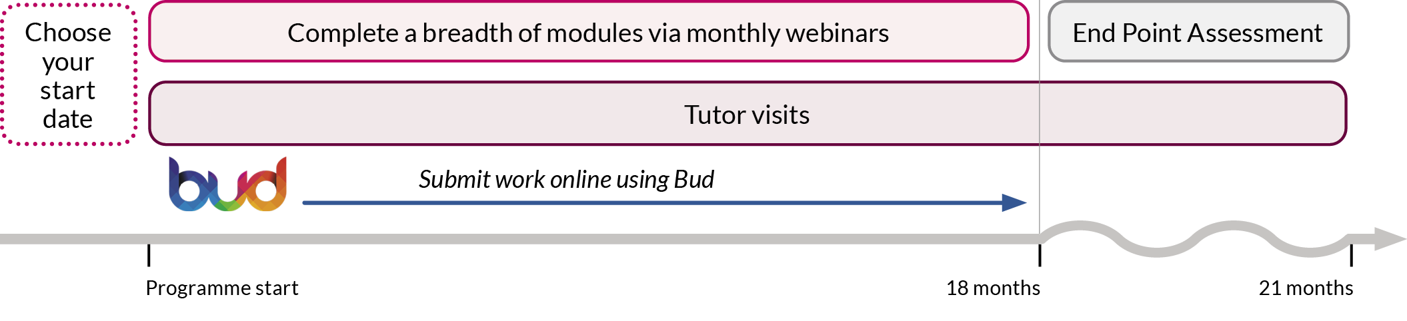
Key Facts
Termly Cohorts:
November
January
May
September
KSBs
21 Knowledge
26 Skills
9 Behaviours

Slide 4
Our Delivery Plan
Blended Programme of face to face and online study
Additional study units on our VLE
Specialist 1-2-1 Early Years Tutor Support
Study Skills Support
Regular Reflections on Learning and Practice
Partnership working between BPN, the apprentice and the employer

Slide 5
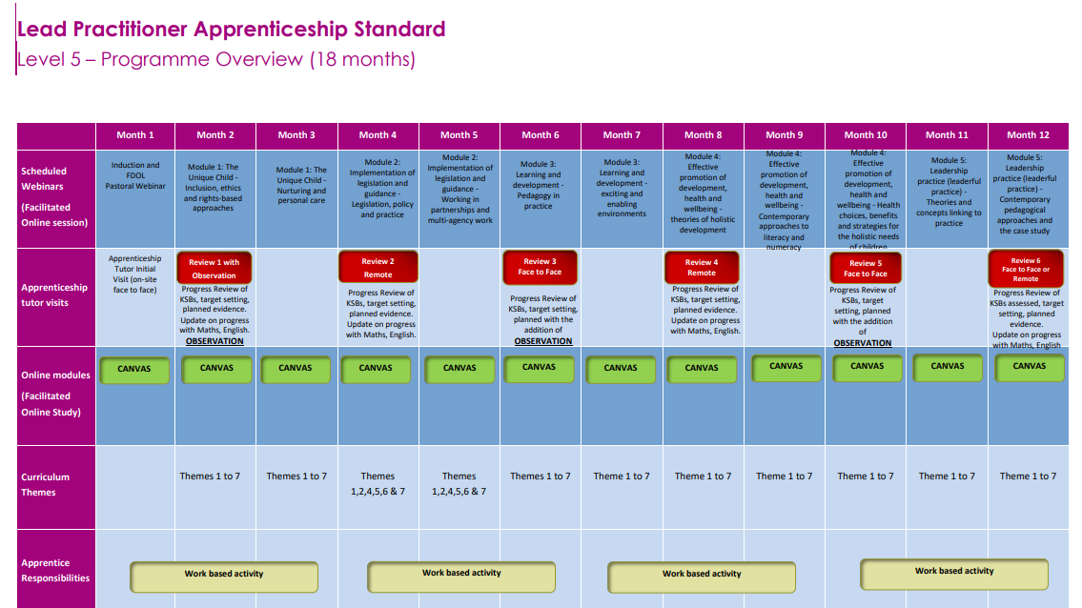

Slide 6
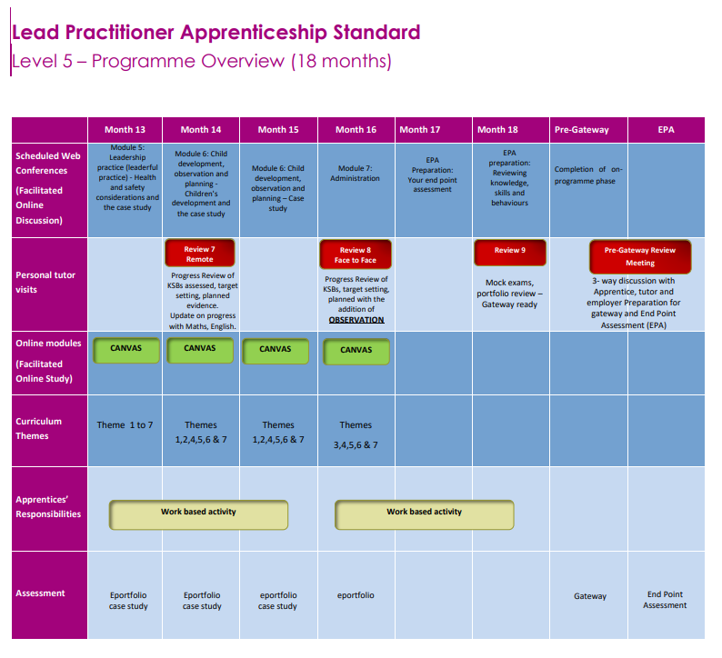

Slide 7

Our Curriculum
The curriculum encompasses the totality of apprentices’ learning experiences throughout their time on the programme.
We believe our curriculum is broad, balanced, relevant and forward thinking in order to meet the needs of the Early Years sector and raise outcomes for all children.
Immersion in the curriculum and the experiences it offers will prepare apprentices for their future career as Early Years Lead Practitioners.
Vision: Our belief is that every child must have access to an excellent early years’ education, regardless of their background, and that every apprentice must be supported to be their best.

Slide 8
Our Curriculum Themes
Child Development and Pedagogy
Curriculum
Observation, Planning and Assessment
Leading Practice
Equality, Diversity, Supporting Children’s Strengths and Needs
CPD and Reflective Practice
Current Legislation, Safeguarding, Health & Safety

Slide 9
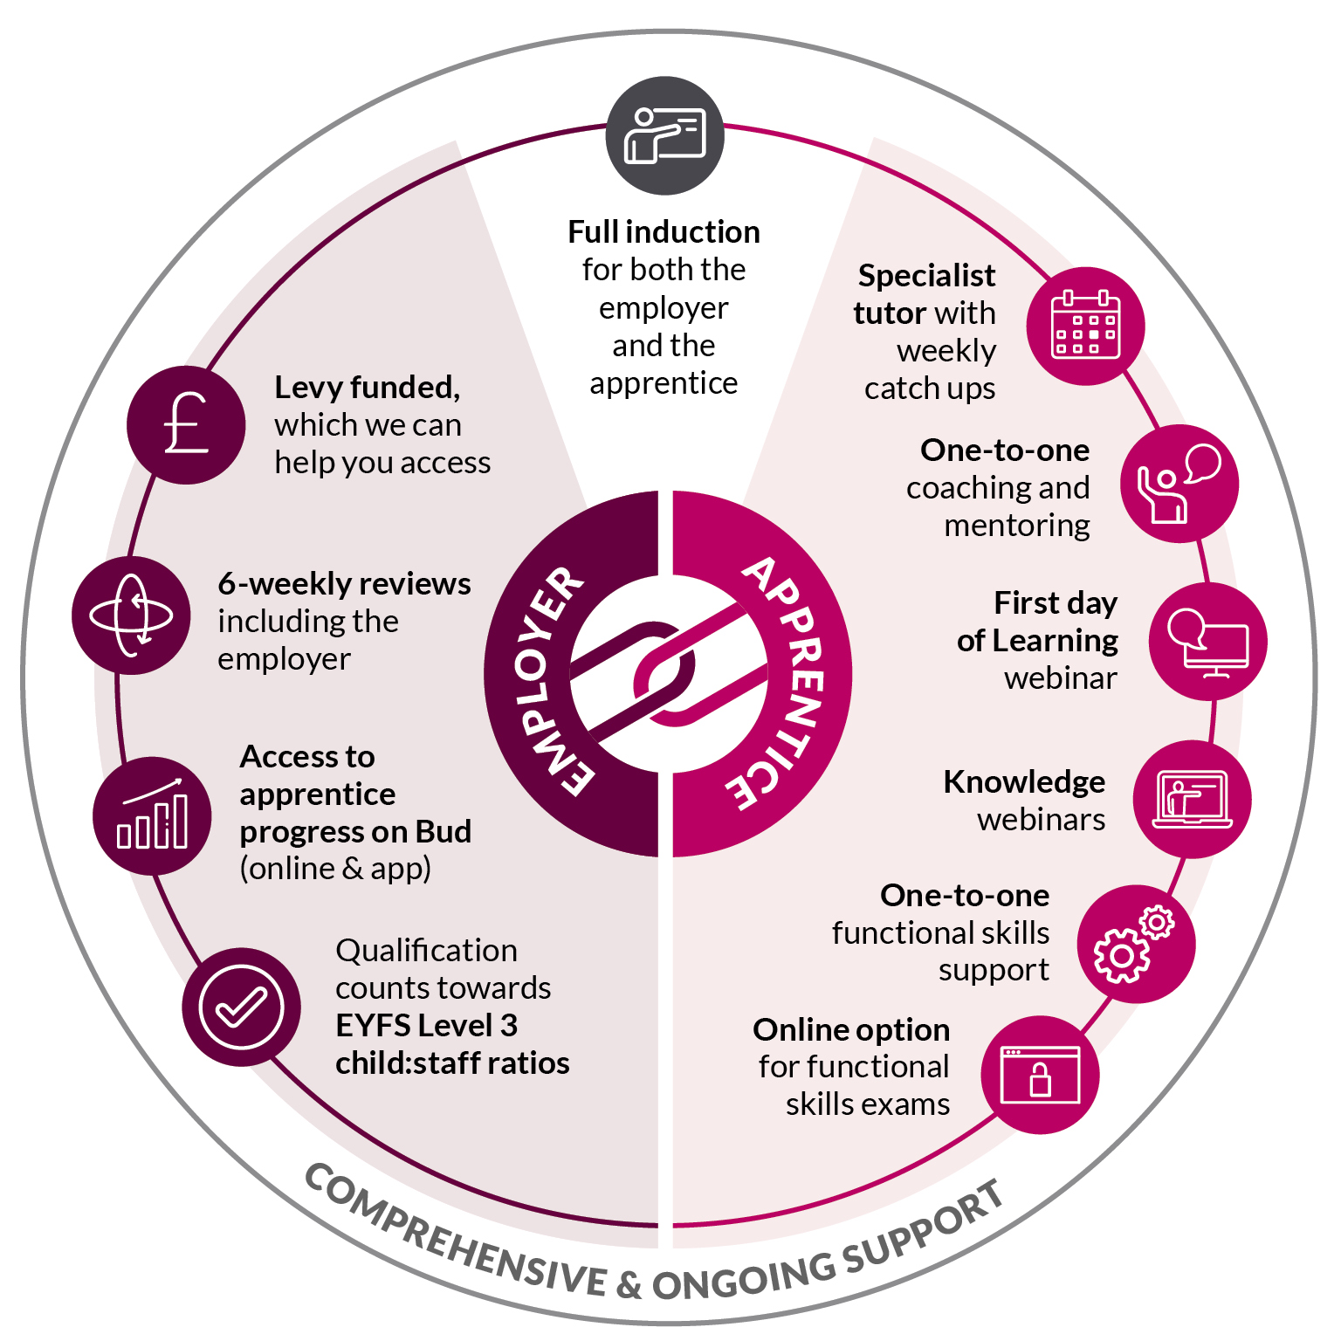
Why Choose Best Practice Network

Slide 10
End Point Assessment
Observation with Questions
An observation with questions involves an independent assessor observing and questioning an apprentice undertaking work, as part of their normal duties, in the workplace. This allows for a demonstration of the KSBs through naturally occurring evidence.
Professional Discussion underpinned by a Portfolio of Evidence
A professional discussion is a two-way discussion which involves both the independent assessor and the apprentice actively listening and participating in a formal conversation. The apprentice leads the discussion. The portfolio of evidence will typically contain 20 pieces of evidence. (workplace documentation)
Case Study with Presentation and Questioning
The case study report will be based on a case study that the apprentice has done with an individual child or group of children. The apprentice will scope out the case study and present it to the EPAO. The observations, analysis and preparation of the case study report and presentation will typically take 12 weeks. The Case study report will be 4000 words

Slide 11
Early years teaching career pathway
EARLY YEARS TEACHER STATUS
1
2
3
4
5
LEVEL 2
LEVEL 3
LEVEL 5
DEGREE TOP UP
EYITT
Kick off a career in early years with our Early Years Practitioner Apprenticeship Level 2. After completion of the programme work in a range of early years setting, delivering Early Years Foundation Stage (EYFS).
Early years careers can be started or continued with Early Years Educator Apprenticeship Level 3. Apprentices will achieve an EYE qualification which has been approved to count towards the EYFS level 3 child: staff ratios.
The Early Years Lead Practitioner Apprenticeship Level 5 is ideal for highly skilled professionals who take an operational lead for the care, learning and development of all young children within their care.
Best Practice Network work closely with partners who deliver a 12-month top up programme, giving you a degree on completion and the qualification levels required to progress on to EYITT.
Finally, completing Early Years Initial Teacher Training awards Early Years Teacher Status (EYTS), and as the leading Early Years Initial Teacher Training (EYITT) provider in the country, we boast a 100% pass rate.
BEGIN CAREER

Slide 12

Any questions?

