Slide 1
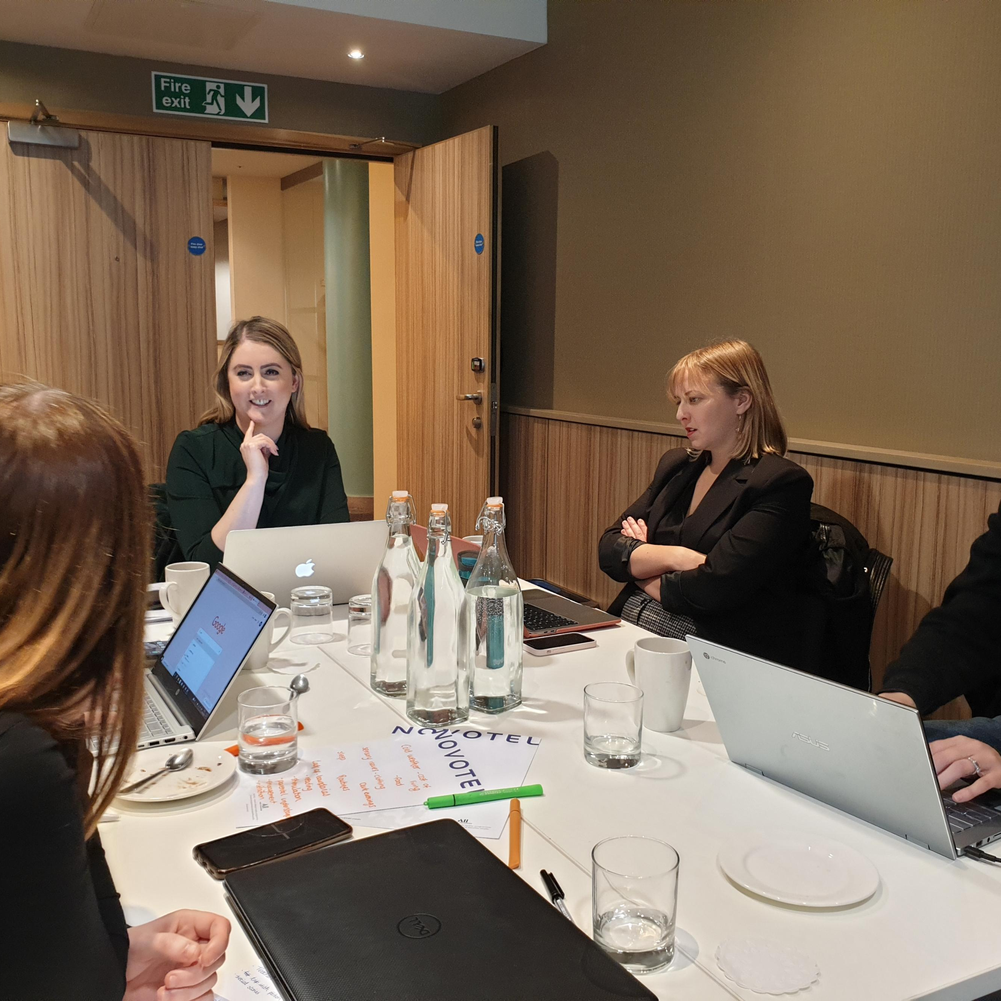
Teaching Assistant
Level 3 Apprenticeship

Slide 2

Agenda
  Who are we?
  Programme overview & delivery
  Recruitment
  Funding
  Next steps
  Q&A

Slide 3

Who are Best Practice Network?
  Apprenticeship provider supporting 2000+ apprentices
  Accredited national ITT provider
  Accredited lead provider for ECF and NPQs
  Ofsted Outstanding Provider, 2023
  Education and Childcare Apprenticeship Provider of the Year, 2023 & 2024

Slide 4

Teaching assistant L3
Ideal for anyone working in or looking for a career in a teaching support role
15 month programme + 3 months EPA (dependant on working hours)
Functional skills maths and English L2 required if apprentice does not already have equivalent qualifications
Learners will be able to personalise their pathways based on their choice of specialist area(s)
Entry Requirements
Apprentices must meet the following criteria:
Be employed as a Teaching Assistant
GCSE grade 4/C or above in English and Maths, or able to achieve Level 2 whilst on programme
Resident of the UK for the past 3 years

Slide 5
Our Delivery Plan
Blended programme of face to face and online study
Specialist 1-2-1 Tutor Support
BPN boost – personal development, career information advice and guidance and welfare programme
Regular reflections on learning and practice
Partnership working between BPN, the apprentice and the employer
Progress reviews every 6 weeks

Slide 6
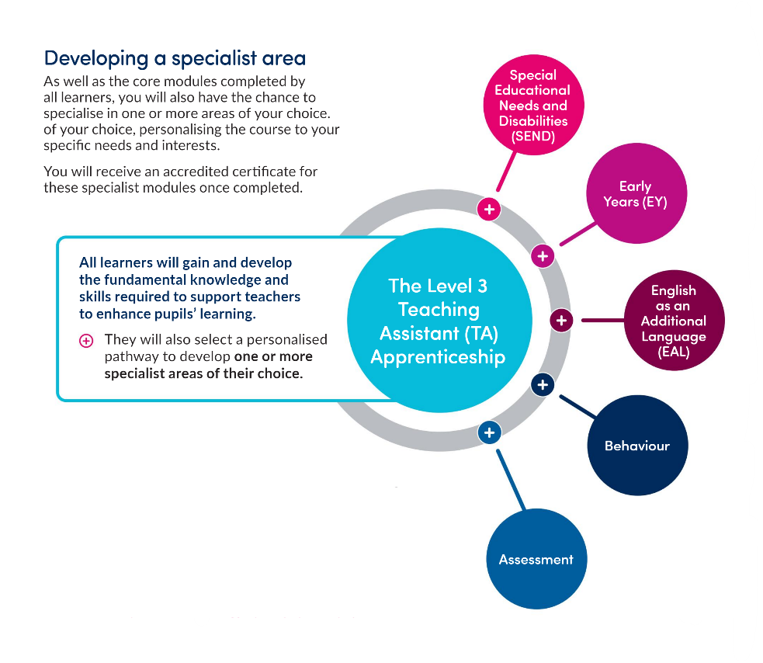
Developing a Specialist Area
All learners must select and complete one accredited specialism on programme
Can select more than one but it shouldn’t interfere with the job role or core apprenticeship programme
Certificates for any specialist area completed successfully

Slide 7
What will I learn?
How pupils learn and develop
Learning support
Behaviour and pastoral support
Curriculum
Assessment
Technology
Professional relationships
Legislation and policy
Notes:
8 modules – these are split across 14 online sessions. Modules are designed in a way that allows learners to revisit and build on previous knowledge taught to ensure they are confident in all the topics required.

Slide 8
Employer requirements
Allow time for apprentices to attend monthly webinars
Provide apprentice with 6 hours per week (FT) or 20% off the job training (PT)
Attend learner reviews
Provide your apprentice with a mentor
Provide regular support, feedback and guidance to the apprentice
Provide apprentices with opportunities to develop their knowledge, skills and behaviours

Slide 9


End Point Assessment
Assessment method 1: Observation and questioning
Assessment method 2: Professional discussion underpinned by a portfolio of evidence

Slide 10
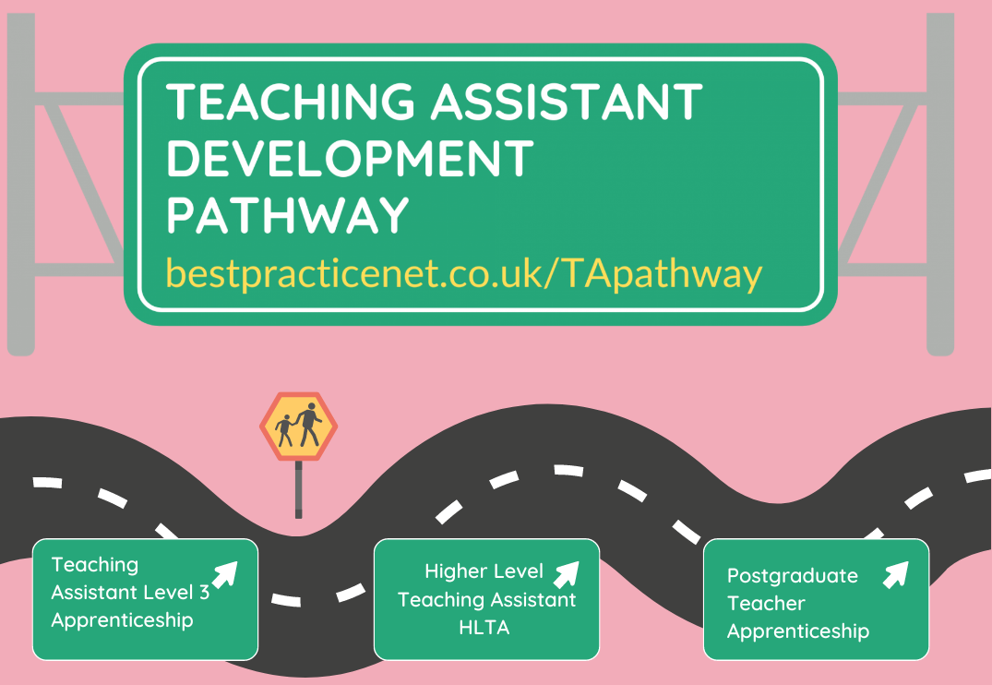
Career progression for apprentices
https://www.bestpracticenet.co.uk/TApathway

Slide 11
Continuous discount
Complete a TA Level 3 with BPN and Fast-Track Your HLTA Certification:
Preparation Fee Reduction:
  From £290 + VAT to £230 + VAT
Reduced Preparation Time:
  15% less online preparation due to familiarity with content
Less time generating evidence for HLTA area of expertise:
  As you will have developed a specialist area as part of your apprenticeship
Exemption from Level 2 Maths and English eligibility proof

Slide 12
Applications
Candidates are then invited to a screening call. The first section of the call will go through the eligibility for the programme. Such as whether they have been a resident in the UK/ EU for 3 years, if they are currently in any education/on another programme and their GCSE results.
The second section is interview preparation. We understand interviews can be daunting for some young people, so we like to prepare them for what they could be asked in an interview. We then ask about their passion of working with children and any experience they might have.

Slide 13
Next steps
We request a CV from the candidate who is encouraged to mention their interests, why they think they would be a good fit as an apprentice in the setting and their experience (if any).
CVs and screening forms are sent over to the hiring manager of the setting to review and they make the decision regarding an interview.
If interviews are to be conducted, the hiring manager will let us know suitable times and dates. We will book the candidates in and ensure they are prepared (i.e. know how they are getting there, what they need to take.)
If successful, our recruitment teams will hand over to our apprenticeship team who will start the onboarding process of enrolment. Hiring managers are then responsible for requesting DBS and references for the apprentice.

Slide 14



Funding
Total cost of apprenticeship is £7,000
Levy funded
Co-investment
Levy Transfer
Funded through the school's apprenticeship levy or Local Authority
School covers 5% Government covers 95%
Total cost to school =£350
School can apply for a transfer of funds
- HERE
Contact our friendly apprenticeship team to confirm the availability of funding for your setting

Slide 15
Hear from current learners
“It’s so interesting! I work with SEN children, and I am learning how to be a better TA and how to support them with their learning”
“The children will benefit most from me being confident and supportive whilst helping them learn.”
“I’ve Learnt new skills and ideas whilst boosting my confidence”
“I have learnt different ways to support children and how resources can be adapted so I can practice this myself when and where necessary.”
“The course is allowing me to notice the children I need to spend extra time with and support.”
“I found it interesting to talk to TAs from other schools and to see how the early years impacts the students as the come up to secondary school”

Slide 16
Recruitment
Setting up a vacancy
Our process starts from receiving the vacancy enquiry, this could be through an email/call or our vacancy form. An initial call is requested to discuss how we work as a training provider, the programme, your responsibilities as an employer and the job post itself (if needed).​
We post your vacancy on our main platform, this is the Digital Apprenticeship Service Portal. Permissions need to be set by whoever oversees this portal, this would be the Employer or local authority/ council. ​
We also have access to other platforms such as Indeed, Reed and Totaljobs, followed by our marketing team that help with our social media and our website.

Slide 17


Questions?
Scan the QR code for more information and to find out how to apply for the next cohort!
Please email enquiries@bestpracticenet.co.uk if you are part of our partner network and looking to apply!

